Slide 1

Snake – Deep Learning

Slide 2
Project idea
Trying to automate the snake game without reinforcement learning
Credits (Tutorial): https://tolotra.com/2018/02/23/tutorial-train-a-tensorflow-model-to-control-the-snake-game/

Slide 3

Data

Slide 4


Data
4 = wall
1 = food
3 = body
1. Step: Calculate max_distance
$$\sqrt{{screentilesX}^{2}+ {screentilesY}^{2}}$$
2. Step: Calculate distance for each object and direction
3. Step: If object doesn’t cross direction, assume distance = max_distance
4. Step: Normalize data (1 = lowest distance, -1 = highest distance)
$$\frac{1−2 ∗observation}{max⁡_distance}$$
5. Step: Save observations with action
Actions:
0 = go left, 1 = go right, 2 = go straight
One hot encoding:
[1,0,0] = go left, [0,1,0] = go right, [0,0,1] = go straight

Slide 5
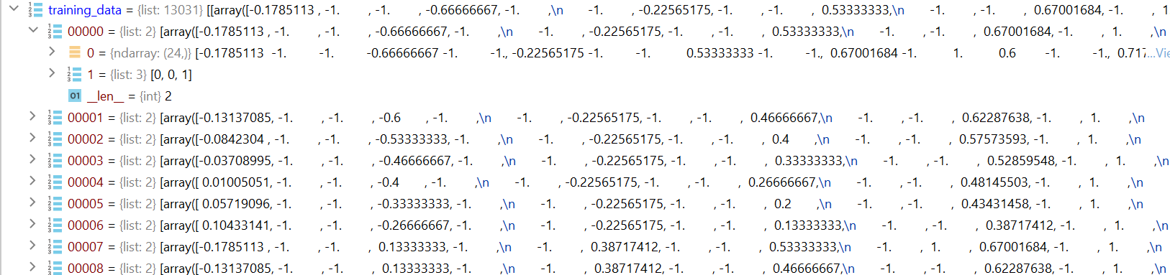
Data example

Slide 6
Data collection
Generating observations by taking random actions
-> action = random.randrange(0,3)
Gerating observations by playing snake by myself

Slide 7
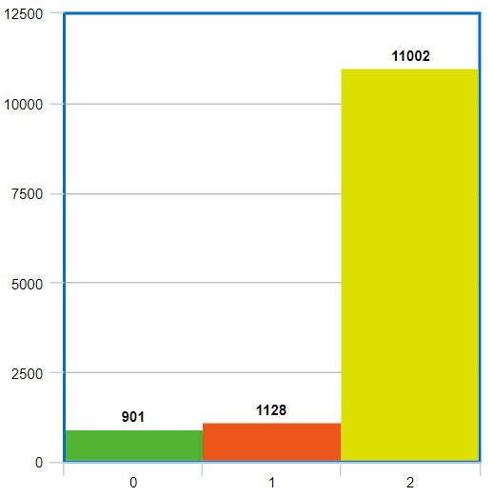
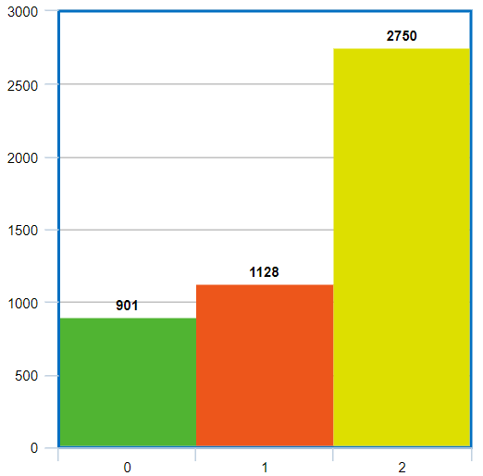
Balancing classifications – Only needed when creating data based on user actions

Slide 8

Neural Network
network = Sequential() network.add(Flatten(input_shape=(24, 1))) network.add(Dense(64, activation='relu')) network.add(Dropout(0.2)) network.add(Dense(32, activation='relu')) network.add(Dense(3, activation='softmax')) network.compile(optimizer=Adam(lr=LR), loss='categorical_crossentropy', metrics=['accuracy'])

Slide 9
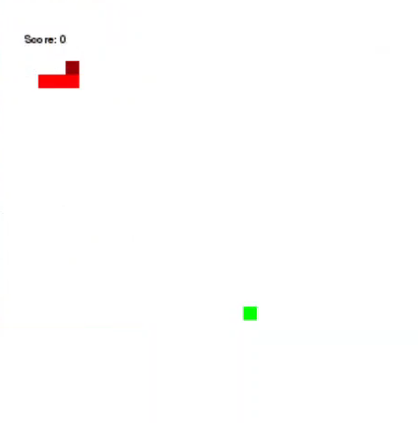

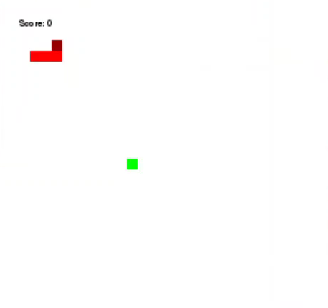
Video Example
user actions
Learning based on …
random actions

